Slide 1




Online Banking Management System
School of computer science and engineering
“ Developing secure and efficient banking
solutions”
DIVESH PANDEY
(23SCSE1180268)
Md. AATIF HASSAN
(23SCSE1180120)
Project Incharge :
MISS RUCHI SHARMA
SHIVAM JHA (23SCSE1180272) KESHAV JHA (23SCSE11550)

Slide 2

INTRODUCTIONS
Overview :
Briefly introduce the Banking Management System and Java.
Banking Management System:
Software to manage banking operations such as customer accounts, transactions, loans, etc.
Why Java:
Java is a widely used, secure, and platform-independent language, making it a strong choice for banking
systems.
Objectives of a Banking Management System-
Automating and managing daily banking operations.
Enhancing security in handling financial transactions.
Providing customer-friendly interfaces.
Ensuring data integrity and consistency.
Faculty Name: Dr. Santosh Kumar Srivastava ame:

Slide 3
STRUCTURAL FORMATION OF THE PROJECT
WHY USE JAVA FOR BANKING SYSTEMS
Platform Independence: "Write Once, Run Anywhere" capability.
Robust Security Features: Built-in security APIs, encryption.
Multi-threading: Supports multiple processes at the same time, crucial for transaction handling.-
Rich APIs: For networking, file handling, and database connectivity.
Scalability: Can handle large-scale systems with ease.
SYSTEMARCHITECTURE ( JAVA-BASED)
Client Layer : GUI applications (Java Swing, JavaFX) or Web interface (JSP/Servlets).
Business Logic Layer : Core functionalities implemented in Java classes.-
Database Layer : Java Database Connectivity (JDBC) used to connect to a backend database (MySQL, Oracle, etc.).

Slide 4

PROBLEMSTATEMENT
Once a time, people have to spend three to four hours to go for bank transaction sometimes cost of transaction was more than that of money deposited or withdrawn. E-banking allows customer to conduct financial transaction on a secure website. Nowadays User Friendly Technology is becoming more popular among customers, most of the banks are providing e-banking facility.
Today, most of the customers are increasingly using the technological banking facilities available in banking sector. It reduces cost and saves time. From the customers perceptive towards technological banking provides a convenient and effective way to manage finance that is easily accessible at 24hours a day in 7 days a week. On the other hand, online banking has certain problems such as lack of knowledge to operate the technology, set-up cost, legal issues, lack of relationship among banker and customer, securely and privacy issues. For some people the User Friendly Technology really simplifies their life style, while for others it is very much threatening and complex. Therefore in this context, it is necessary to study the perception of
customers’ challenges towards User Friendly Technology.

Slide 5
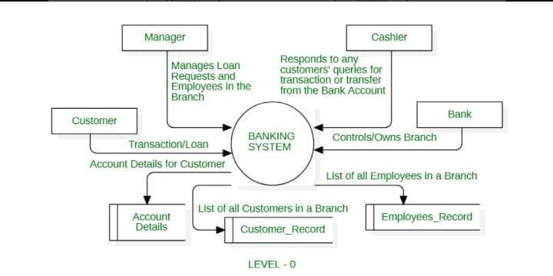
FLOWCHART

Slide 6
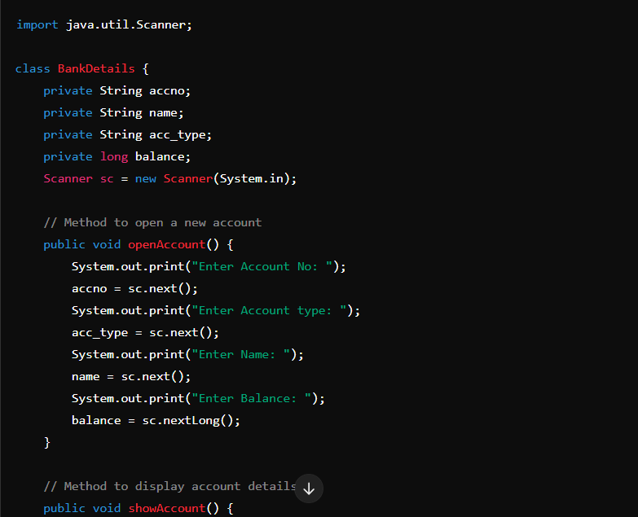
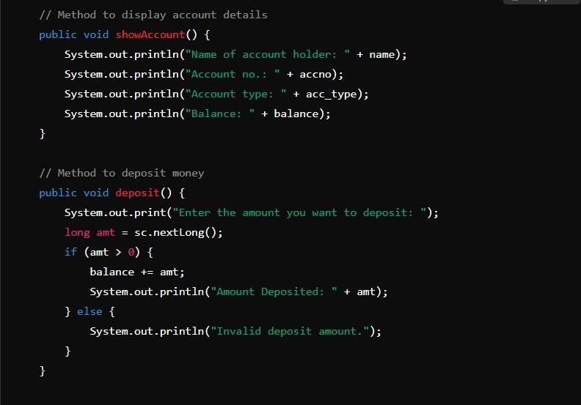
SOURCE CODE {ONLINE BANKING MANAGEMENT SYSTEM}
C
ode of Alarm Clock

Slide 7
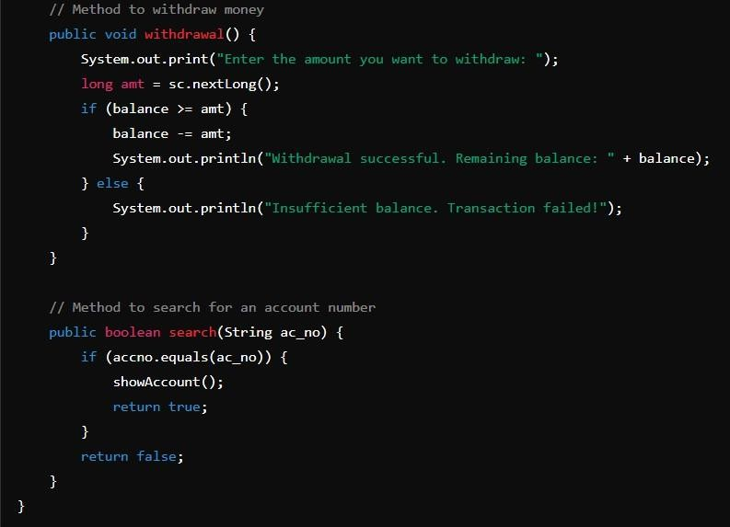
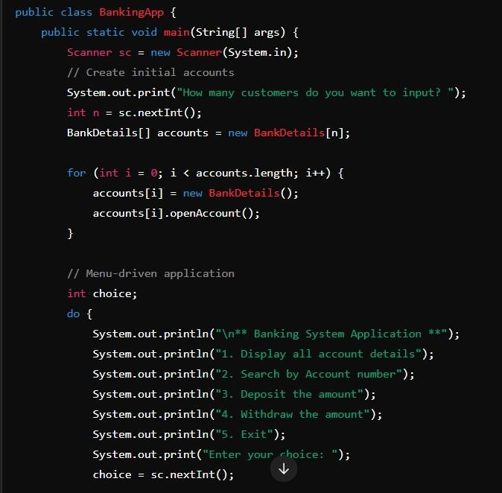

Slide 8
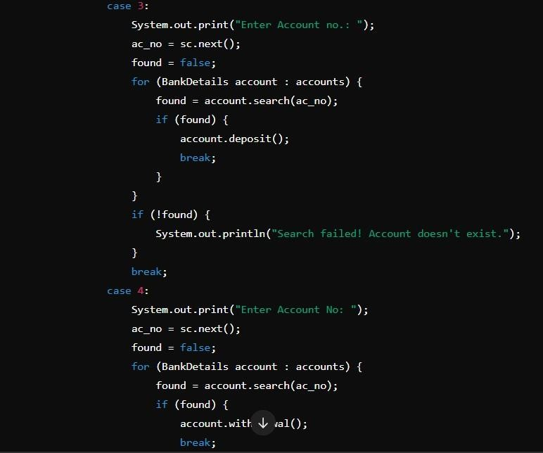
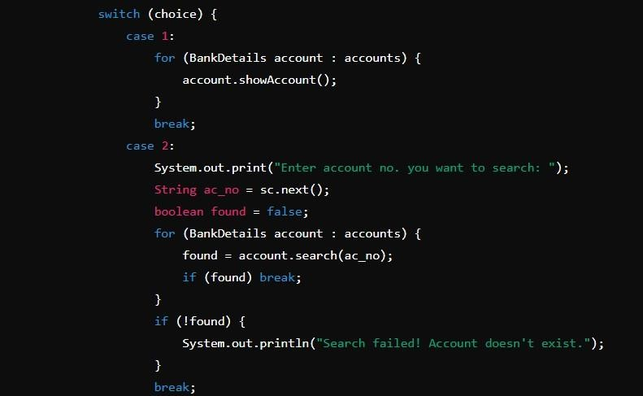

Slide 9
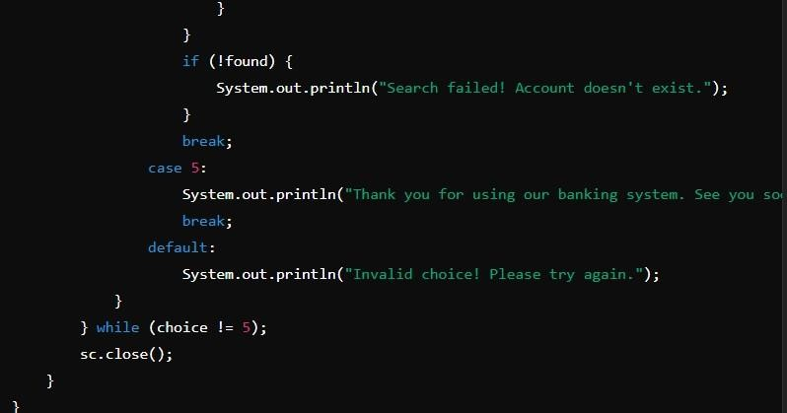

Slide 10

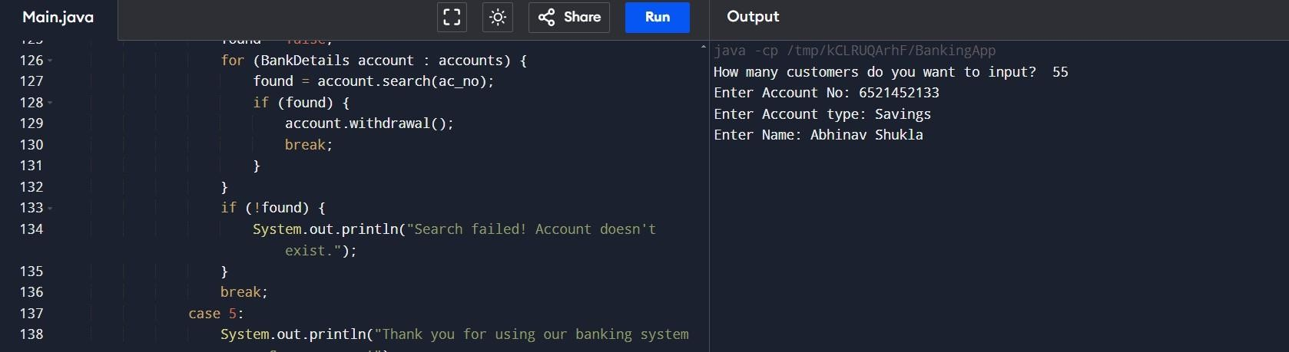
OUTPUT

Slide 11
TECHNOLOGY STACK
Frontend:
JavaFX or Java Swing for desktop applications; JSP/Servlets for web-based systems.
Backend:
Core Java for business logic, using Object-Oriented Programming principles.
Database:
JDBC for database interaction (MySQL, Oracle, etc.).
Security:
Java Security APIs for encryption, SSL for secure data transmission.
Server:
Apache Tomcat (if web-based) or standalone Java applications.

